Slide 1

Cookee
Kendall, Taylore, Timi, Tiffany

Slide 2
Overview
01
03
02
04
Exploring Design Ideas
Task Flows
The Lo-Fi Prototype
Methods & Results

Slide 3
Mission Statement:
Making meal time easy and fun for busy people
Value Prop:
Cook efficiently; Cook enjoyably; Cookee

Slide 4
01
Design Ideas

Slide 5
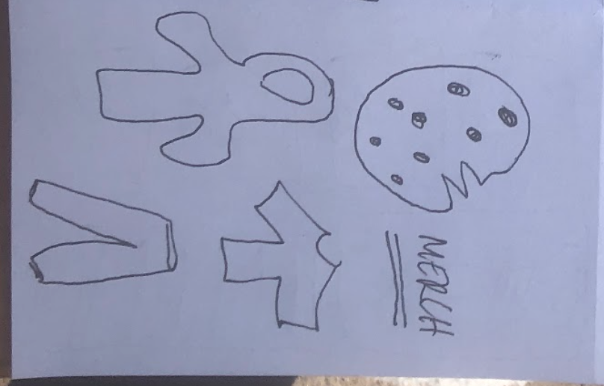
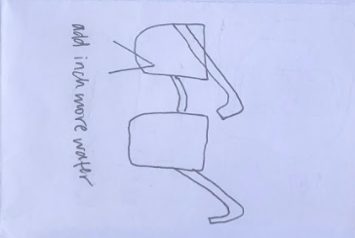
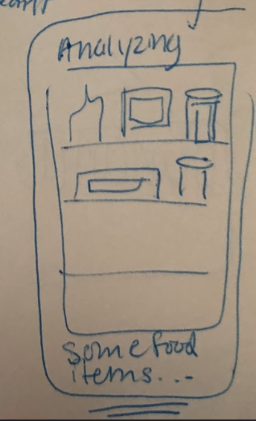
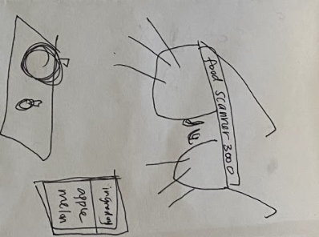
Interface Exploration: VR/AR

Slide 6
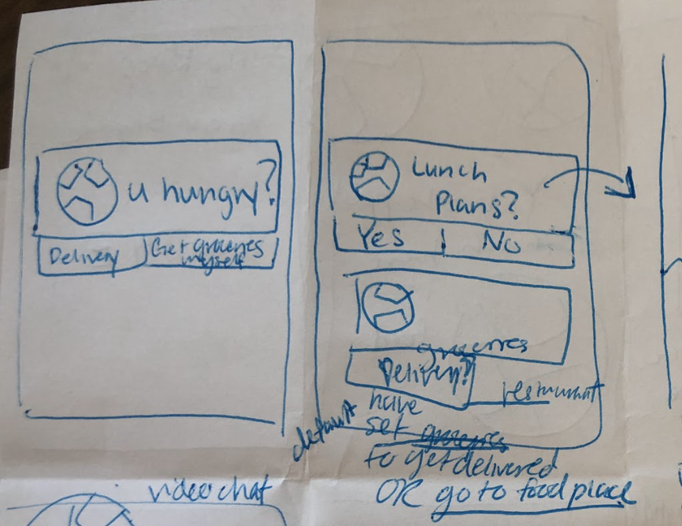
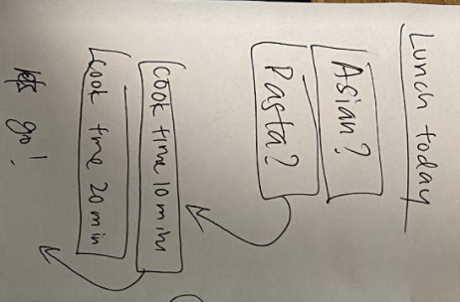
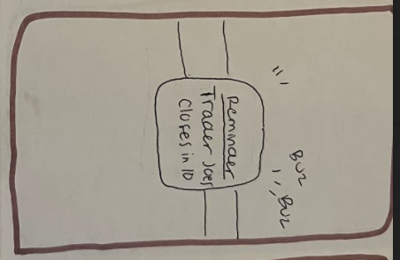
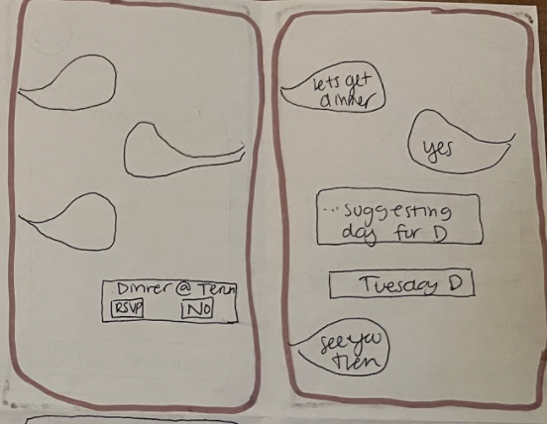
Interface Exploration: Watch/Chat

Slide 7
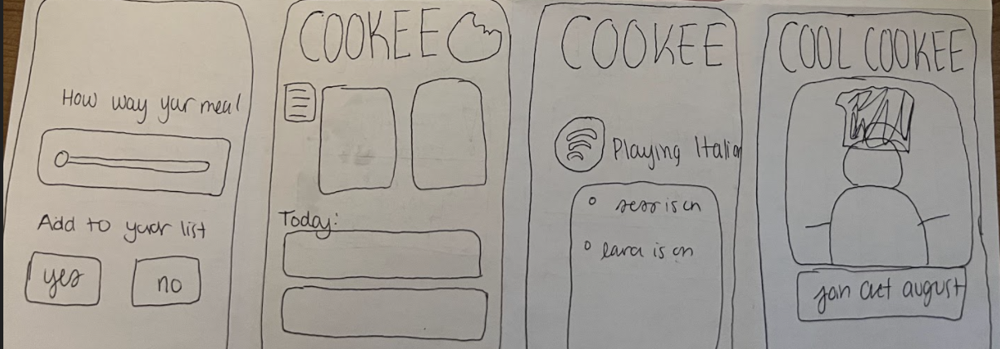
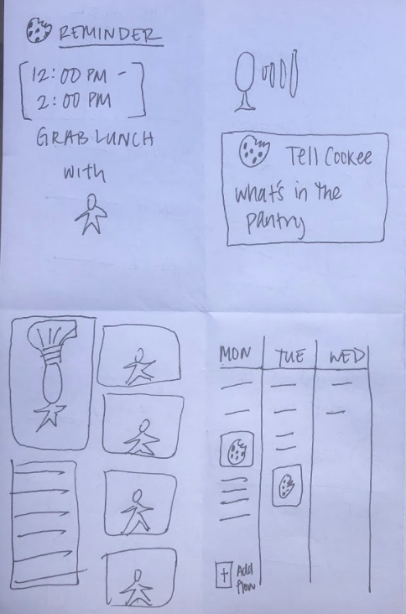
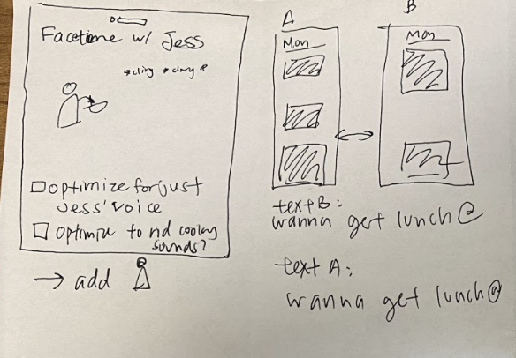
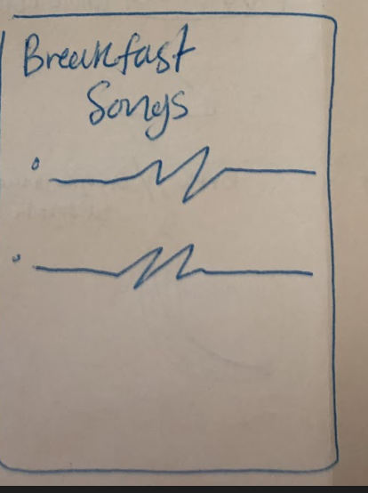
Interface Exploration: Mobile
Notes:
Pros:
Conts

Slide 8
02
The Lo-Fi Prototype

Slide 9
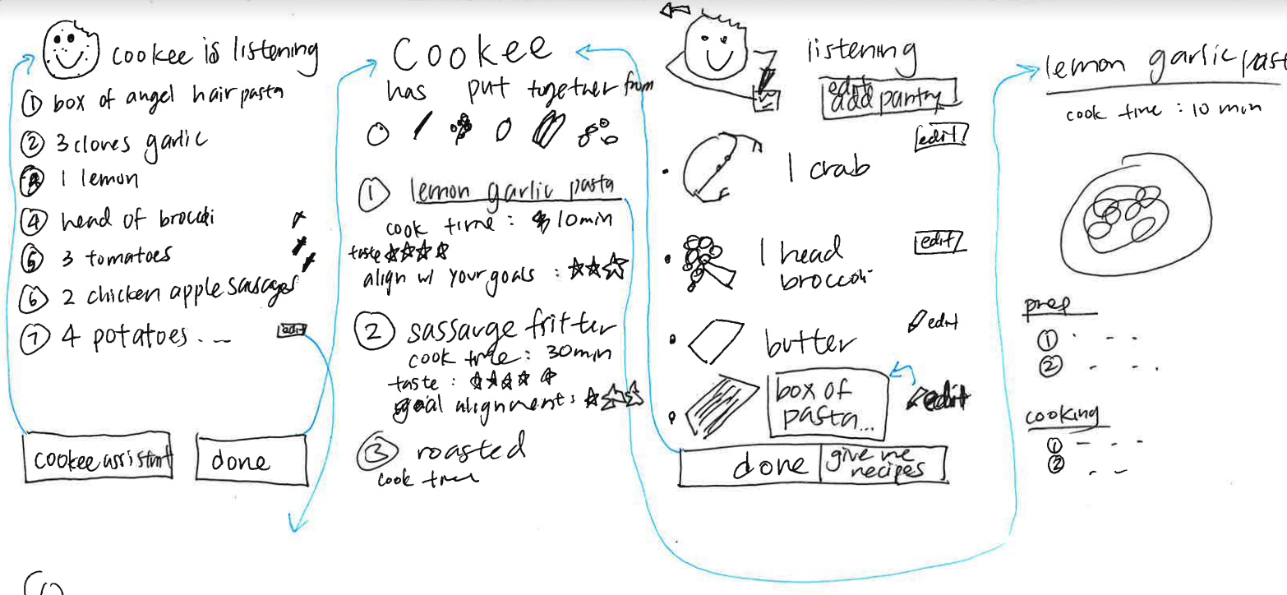
Mobile Task Storyboards
Notes:
Mobile: more people have a mobile phone, syncs with your calender easier, not an additional item, more accessible

Slide 10
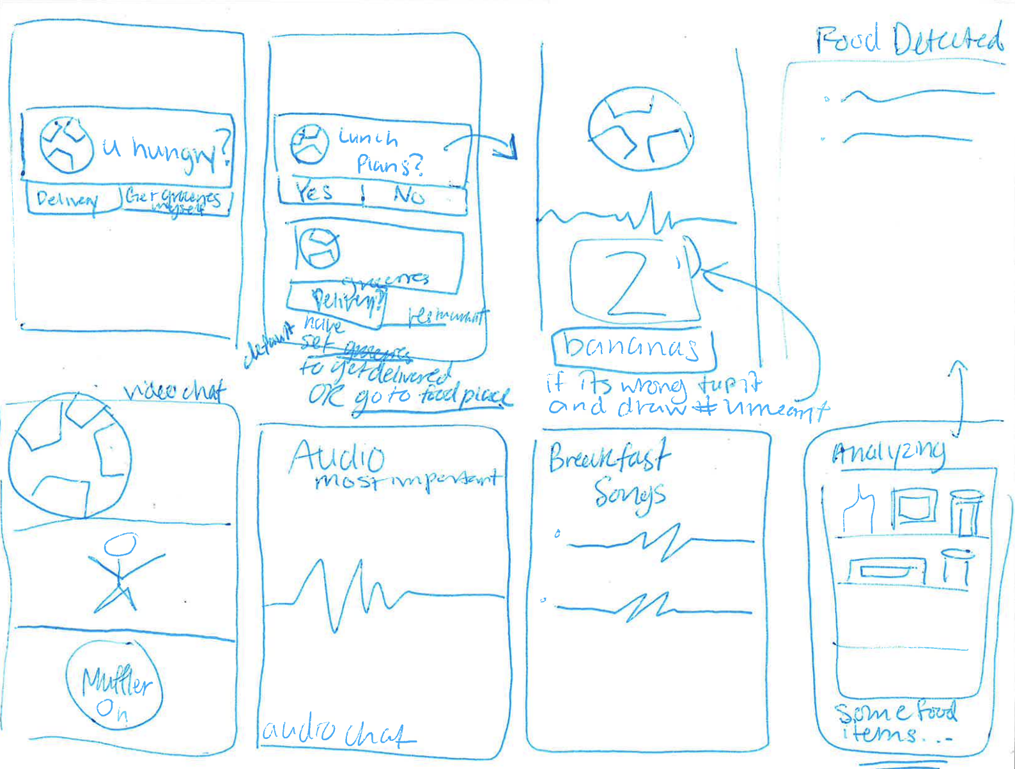
Mobile Task Storyboards

Slide 11
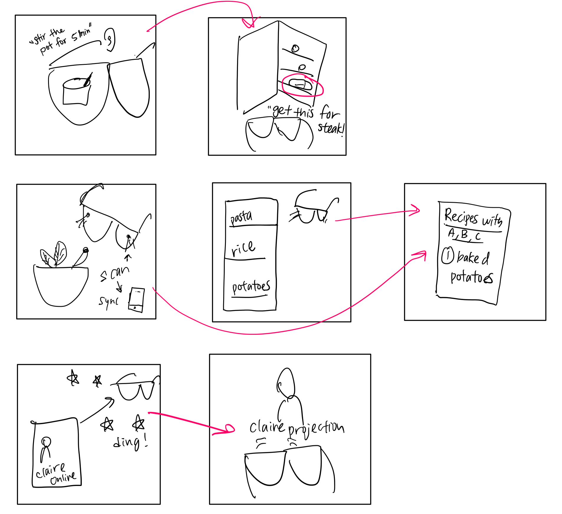
AR Storyboard
Notes:
With augmented reality, it can directly mesh with your physical actions, no extra work needed, more intuitive, save time
Negative: technology is costly, access is low

Slide 12
03
Task Flows

Slide 13
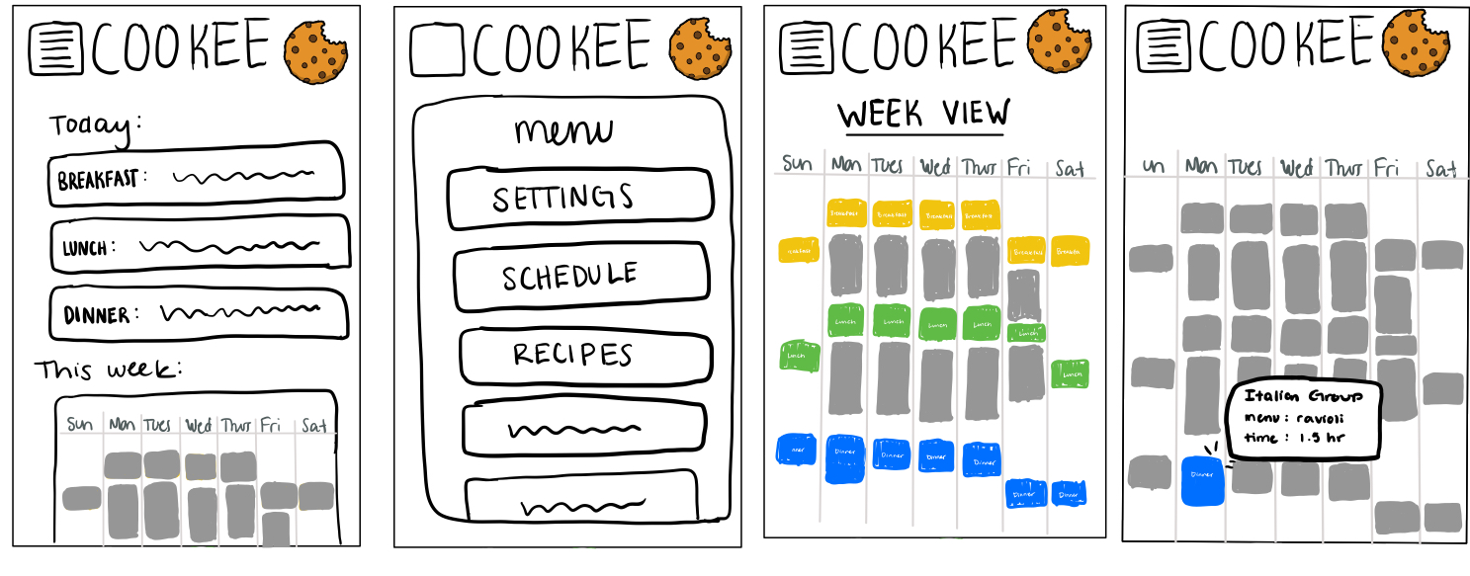
Task 1
Task 1
Establish healthy and consistent eating habits

Slide 14
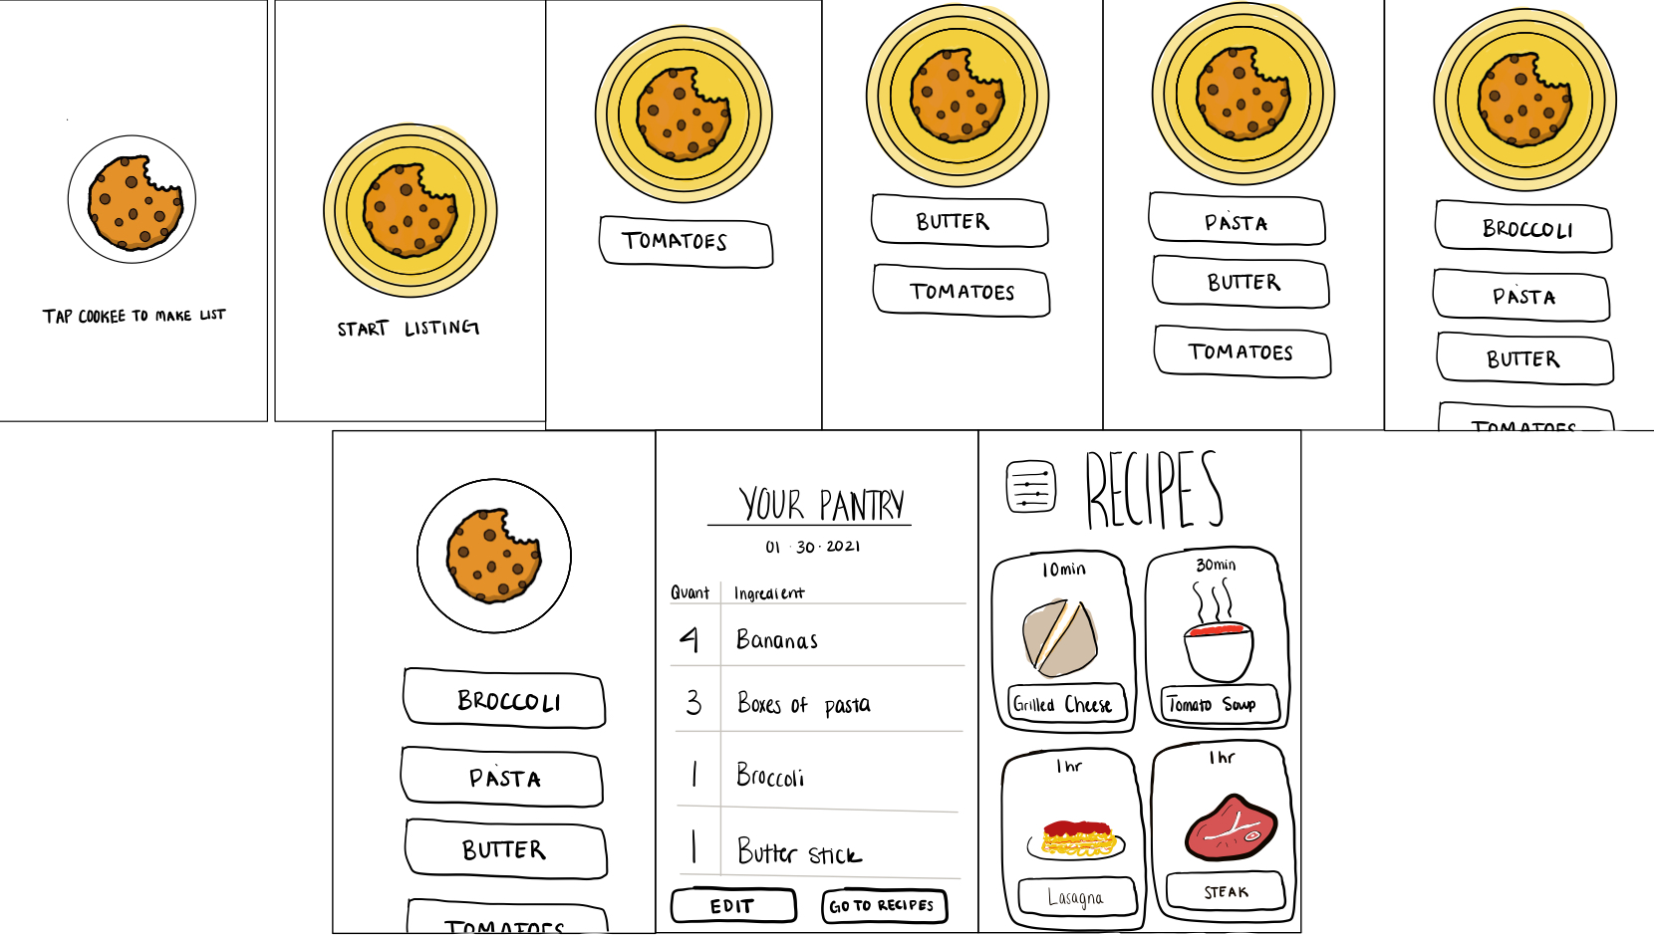
Task 2
Task 1
Create nutritious meals from available ingredients

Slide 15
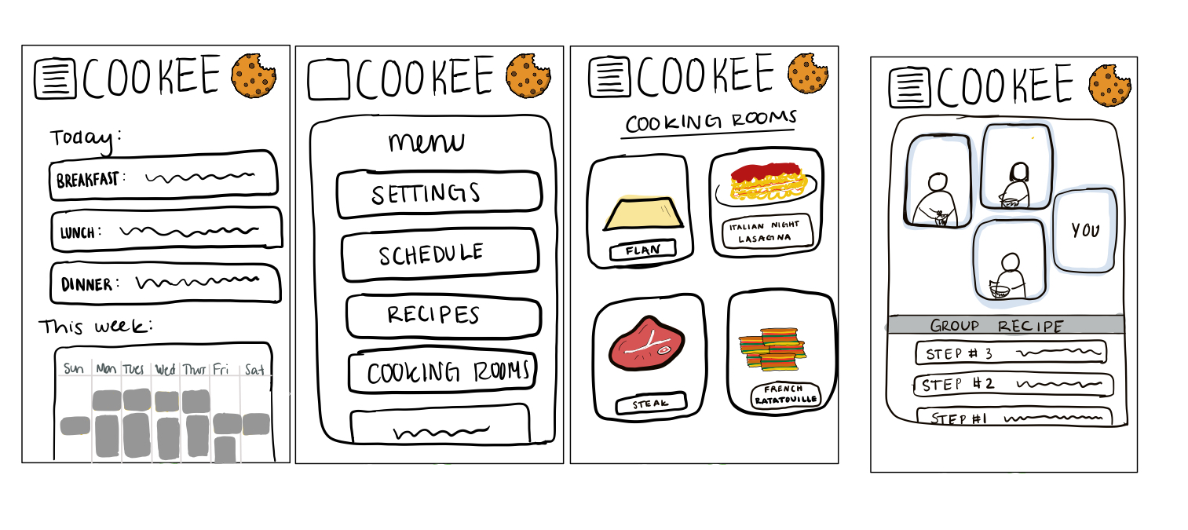
Task 3
Task 1
Bring community into the kitchen

Slide 16
04
Methods & Results

Slide 17
Experimental Method
Approach, give introduction, consent
Introduced task, following script
Ask the participant to execute paper task while talking out loud
Film the user’s hands interacting
Notetaker taking notes of vocalized feedback and frustrations
Facilitator move the different paper components
Asked general questions and offered time for participant to ask questions
Notes:
Timi: facilitator
Kendall: Notes
Tiff: Observations/video

Slide 18
Participant Overview
#1
#2
#3
#4
“Tammy”, a young white professional living in Menlo Park
“Hannah” a Stanford admin living in Palo Alto
“Sam” a Stanford HCI coterm living in EVGR
“Lizzy” a recent Stanford grad now living in Mountain View
Notes:
Selection: working busy women, people we know or referrals, conducted outside at Tressider to get full engagement

Slide 19
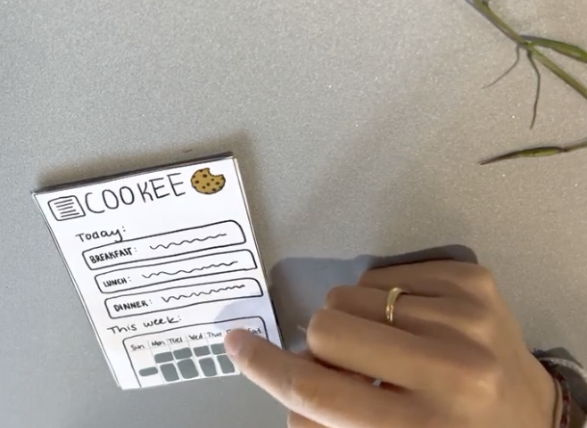
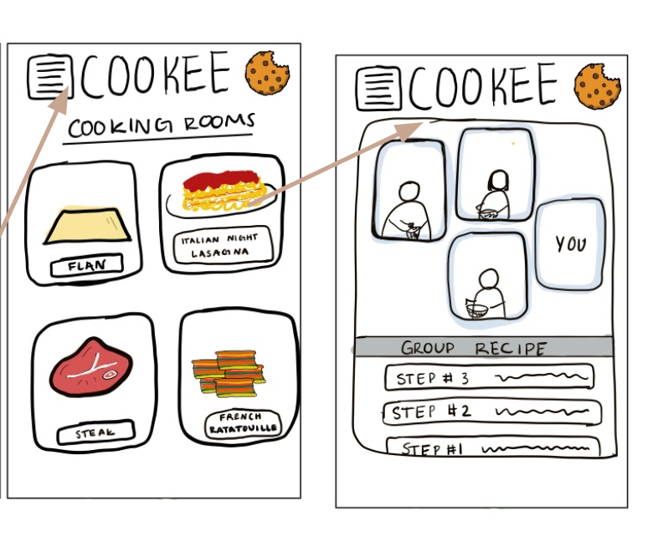
Task 1 Results & Errors
Join the Italian Cooking Room
Once participants navigated to the menu page it was simple to find the Italian room
Two participants tried to access the room through their calendar page rather than the main menu page
One participant wished there had been more information before joining the Italian cooking room
Notes:
scroll

Slide 20
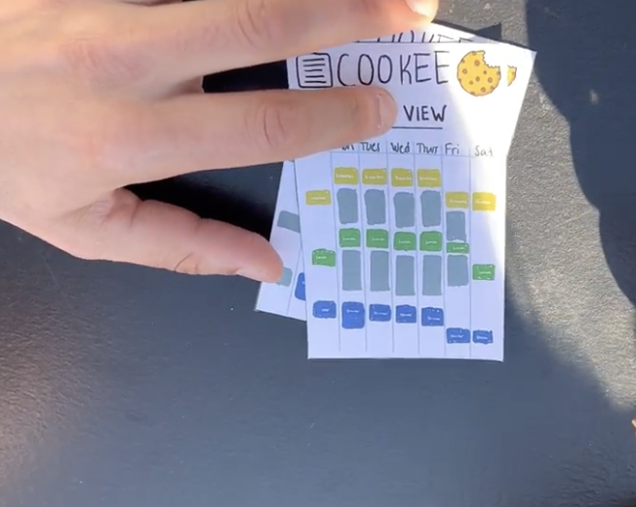
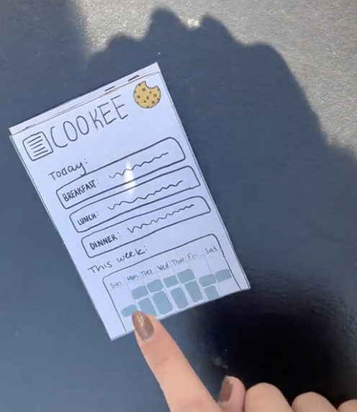
Task 2 Results & Errors
Find your dinner plans for Monday night
Two of our participants felt that navigating to the week view was very intuitive
Three of our participants searched for a day view after navigating to the week view
Participant #1 cautioned that the week view was “overwhelming”

Slide 21
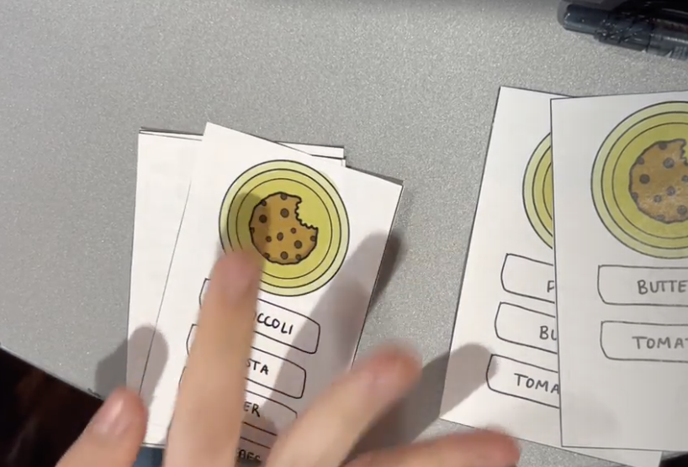
Task 3 Results & Errors
Tell the Cookee app what ingredients are in your pantry, so it can find a meal for you to make
All participants were confused that they needed to speak the ingredients aloud to the app
All participants incorrectly tried to use audio cues to tell Cookee to stop listening
Once participants saw the pantry list, it was intuitive how to navigate to the recipes
Notes:
“Find me the nearest grocery store” “terminado” “end” “stop”

Slide 22
Suggested UI Changes
Add clear on screen instructions like “begin speaking” and “tap to stop” audio
Add more detailed information and an additional confirmation before joining cooking room.
Allow users to find cooking rooms by date & time in addition to by content.
Adding daily views as an option for the calendar feature

Slide 23
Summary

